Slide 1
Career Opportunities

Slide 2
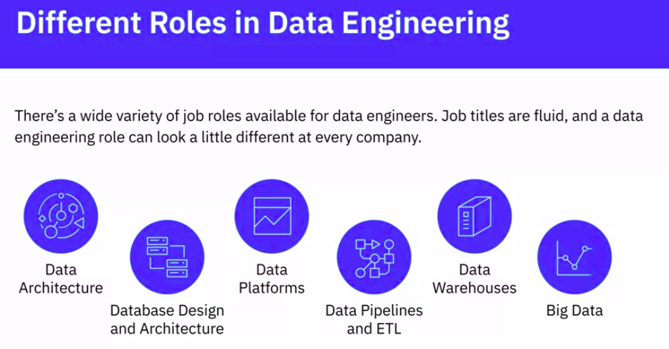
Career Opportunities

Slide 3
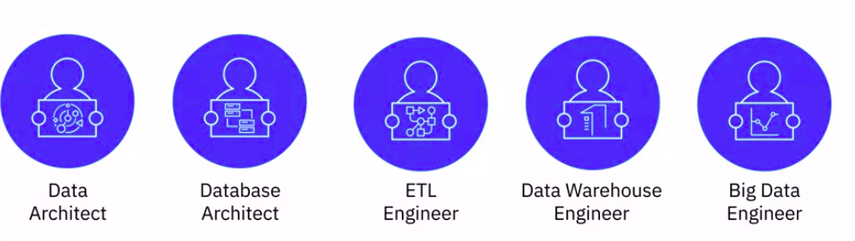
Career Opportunities
But in each of these niche openings, knowledge of operating systems, languages, databases, and infrastructure components, such as virtual machines, networking, and application services, would be a given expectation. As also data’s potential application in business

Slide 4
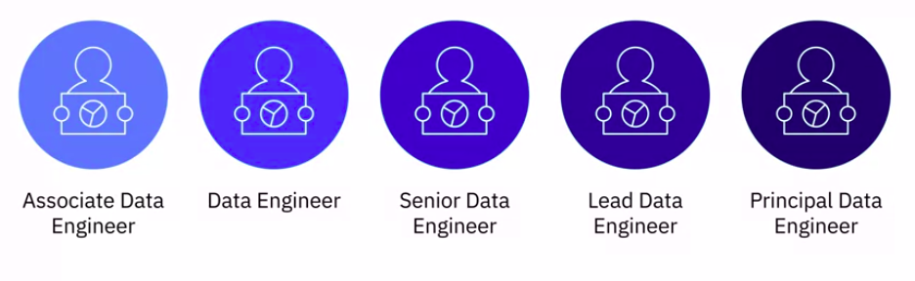
Career Growth Path

Slide 5
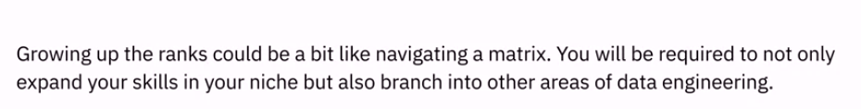
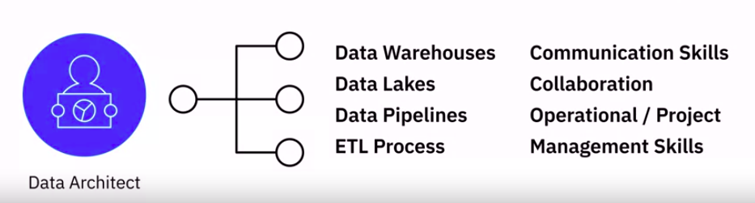
Career Growth Path
Growth in data engineering is characterized not only by the expanse of tools and technologies that you understand and can work with but also how much of the big picture you’re able to see in the data engineering lifecycle.

Slide 6
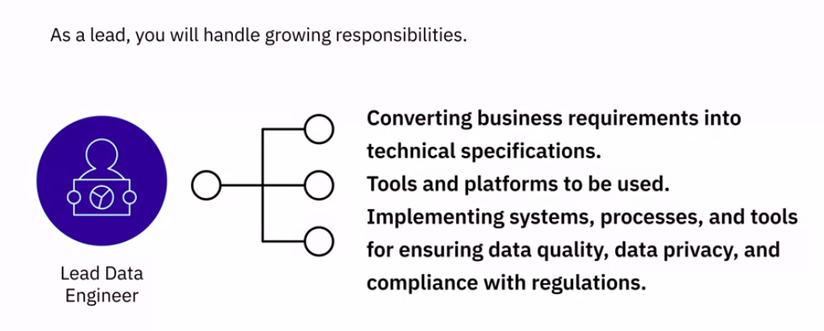
Career Growth Path

Slide 7
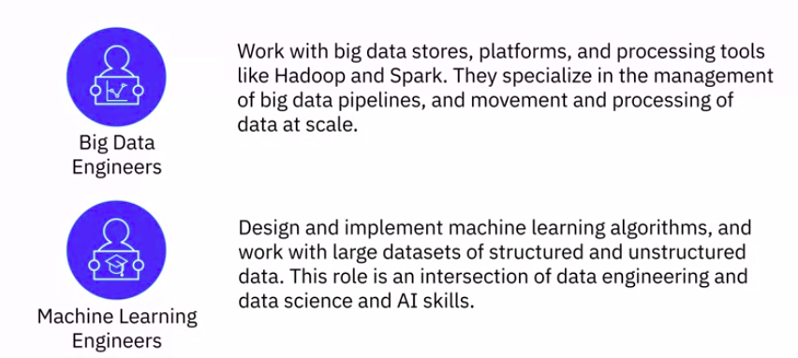
Career Growth Path

Slide 8

Career Growth Path

Slide 9
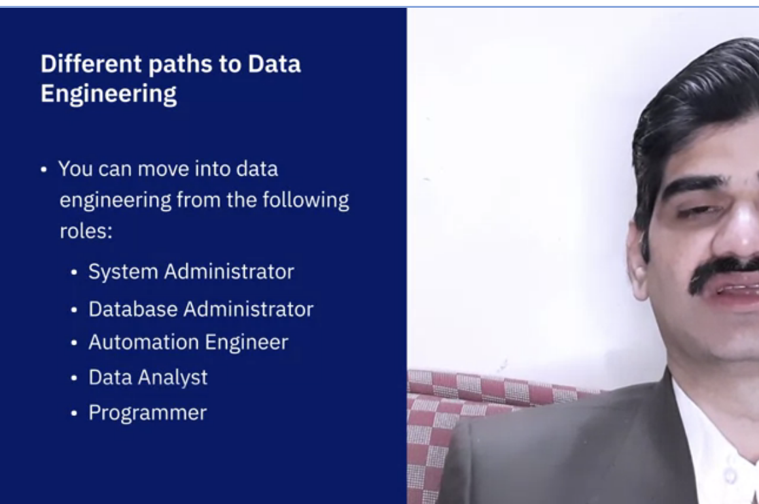

Slide 10
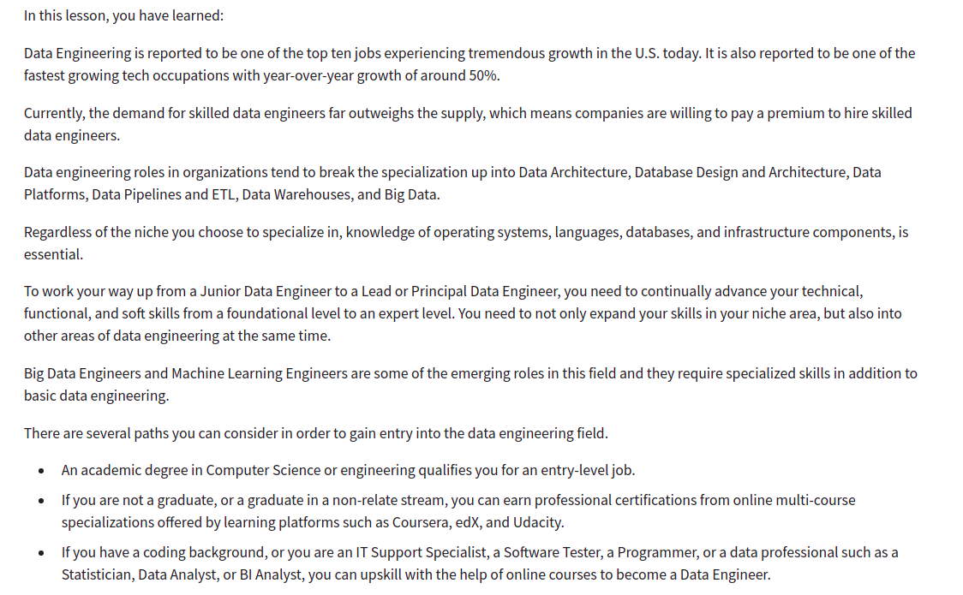
Recap

